Slide 1
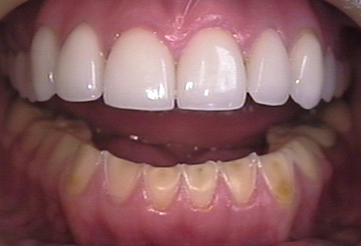
Marley Cooper Bulimia Information
Bulimia is a serious eating disorder marked by binging, followed by methods to avoid weight gain.
More than 200,000 cases each year in the US
Treatments include counseling, medications, and nutrition education.
Bulimia has serious health consequences
It can inhibit healthy reproduction
Signs:
Binge eating
Vomiting after overeating
Anxiety
Guilt and mood swings
Bad breath
Dental cavities and dryness
Inflamed esophagus
Heartburn
Depression
Sore throat
Fatigue
Poor self esteem
Hunger
self - harm
Bulimia nervosa is a serious, potentially life-threatening eating disorder characterized by a cycle of binging and compensatory behaviors such as self-induced vomiting designed to undo or compensate for the effects of binge eating. According to google it mainly starts to affect people at the age of 14 and continues 60 and up.
Lab tests or imaging is rarely done. Bulimia nervosa can last for years or a lifetime, but it’s treatable by a medical professional.

